Slide 1

DAYANANDA SAGAR ACADEMY OF TECHNOLOGY AND MANAGEMENT
DEPARTMENT OF ELECTRICAL AND ELECTRONICS ENGINEERING
“MINI PROJECT”
ACADEMIC YEAR 2022-2023
“SHUI : SMART HOVERBOARD USING I OT
SEMINAR PHASE-1
SUBMITTED BY:
ANANYA SHEKAR(1DT20EE003)
ANNAPURNA(1DT20EE004)
GOUTAMI V NAIK(1DT20EE012)
VAISHNAVI H M(1DT20EE031)
UNDER THE GUIDANCE OF:
PROF. RENUKA PRASAD G
ASSISTANT PROFESSOR,DEPT. OF EEE,
DSATM, BENGALURU.

Slide 2
CONTENTS
OBJECTIVE 3
COMPONENTS 4
SOFTWARE USED 7
PROJECT UPDATE 8
CONCLUSION 9

Slide 3
OBJECTIVE
Transportation
Self Balanced
Portable

Slide 4
COMPONENTS

Slide 5
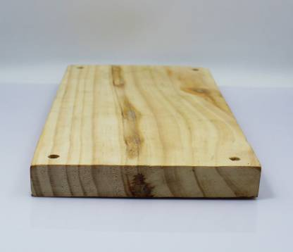
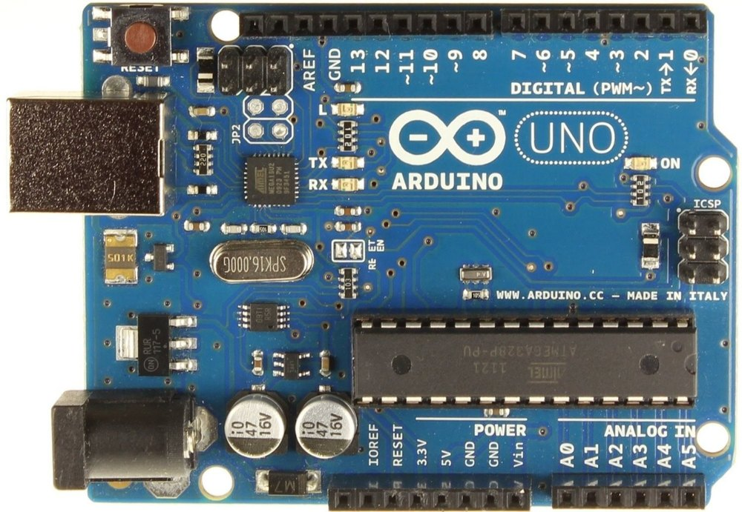
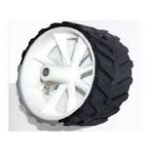
WOODEN PLANK AND A HOLDER
ARDUINO UNO
WHEELS

Slide 6
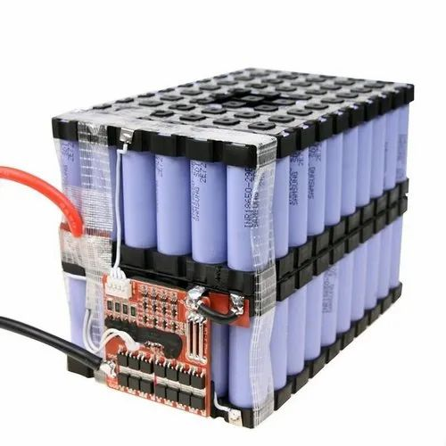
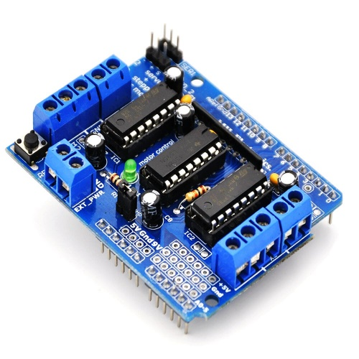
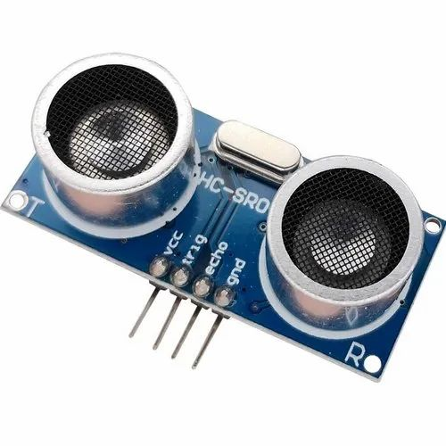
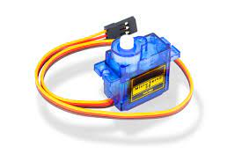
LM298 DC MOTOR DRIVER SHIELD
12V,6Ah,Lithium Ion Battery
ULTRASONIC SENSOR

Slide 7
FLOWCHART:

Slide 8
SOFTWARE USED
ARDUINO
C LANGUAGE
PYTHON

Slide 9
Thank you

